Slide 1
SETP Module
Part 1 -3

Slide 2
Log into OneSchool
Log into OneSchool or search for oslp@eq.edu.au

Slide 3
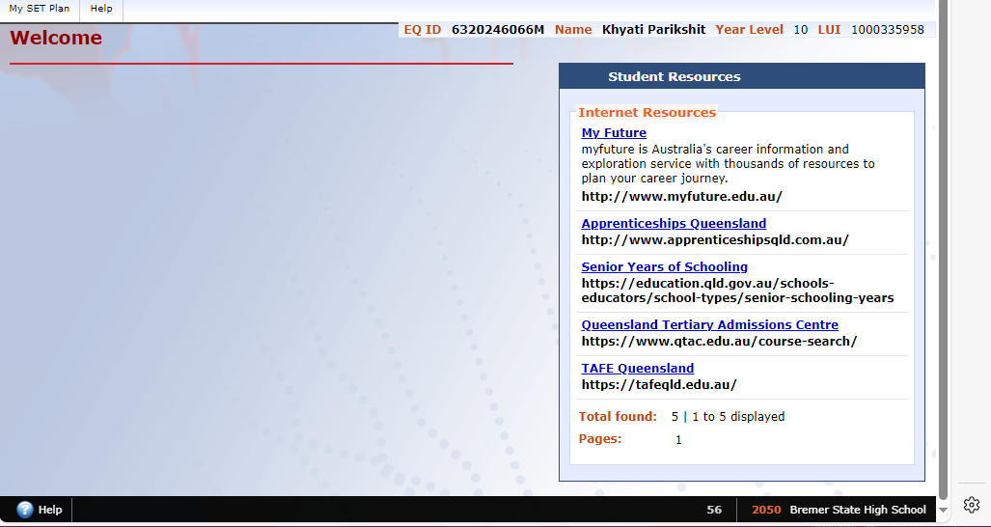
Let’s look at OneSchool
Click ‘My SET Plan’
These are all resources to support you

Slide 4
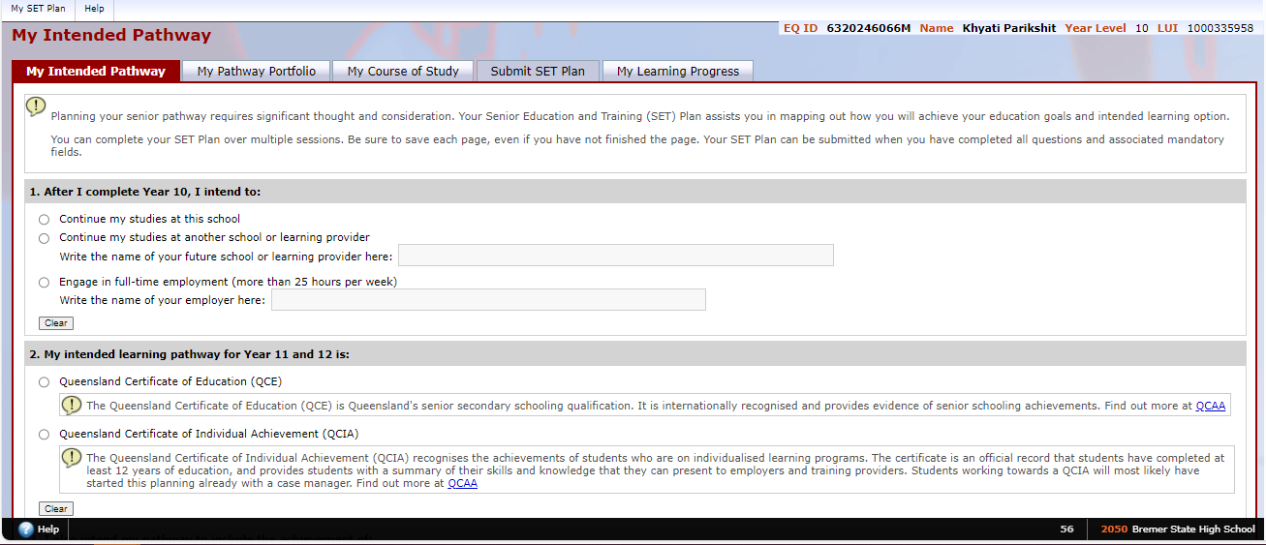
Make sure you save each page even if not finished

Slide 5
1. After I complete Year 10, I intend to:
TAFE, Indi, Apprentice, Busy Schools, etc
Kmart, Coles, Mcdonals etc

Slide 6
2. My intended learning pathway for year 11 and 12 is:
Leave blank if not returning

Slide 7
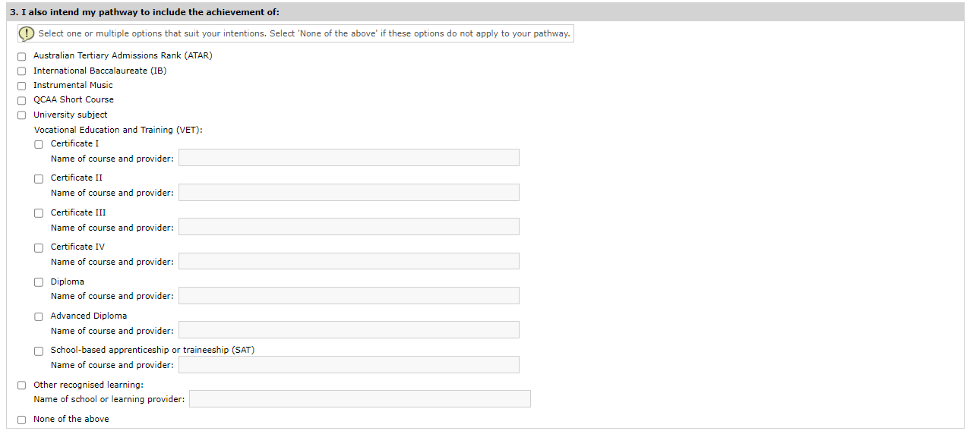
3. I also intend my pathway to include the achievement of:
We do not have this at BSHS
Read through and complete carefully.
Remember you can return to this page if you are unsure now.

Slide 8
4. When I leave school my preferred pathway includes:
Links to request your USI are on the school website
REMEMBER TO SAVE

Slide 9
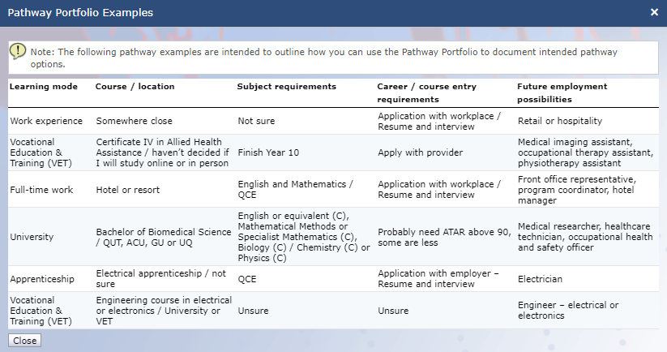
Don’t forget to hit save

Slide 10
Subject selection phase of SETPs

Slide 11
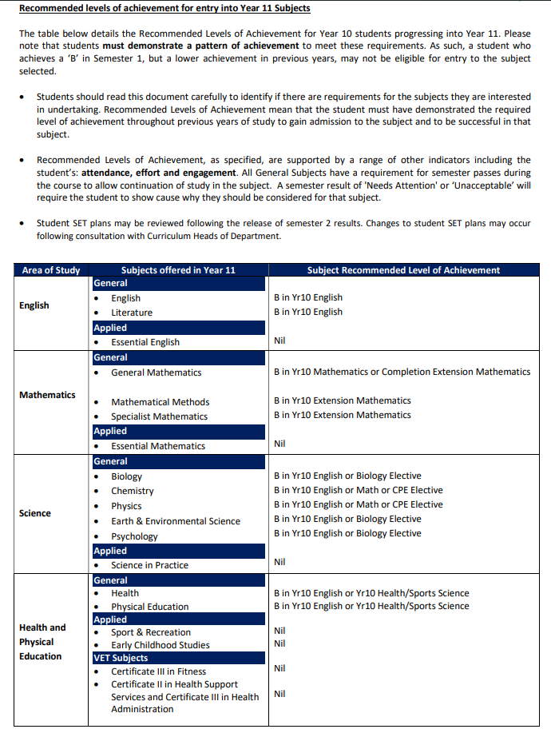
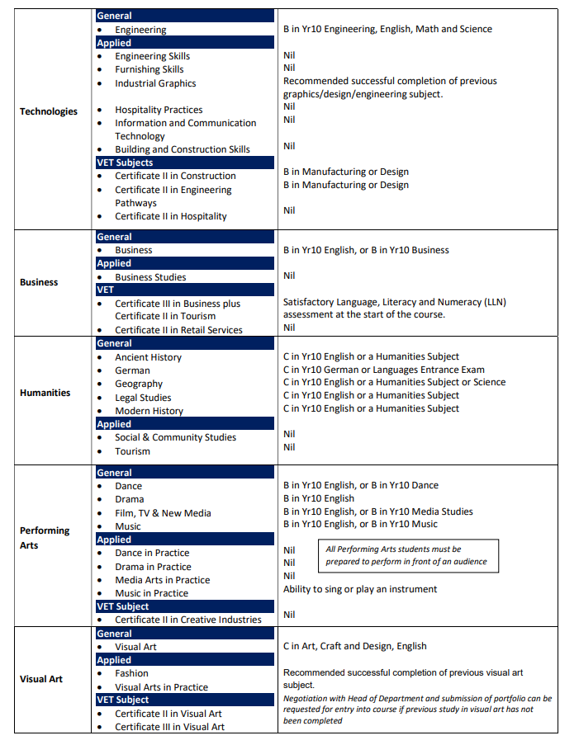
Consider Recommended levels of Achievement
When selecting subjects consider the Recommended levels of achievement to see if you will likely be successful in a subject

Slide 12
Process
Smorgasbord - week 10
This allows us to see what subjects you want as a cohort. Then we can determine which subject have enough interest to run.
Line select - week 3
When we know which subject can run an algorithm is run to determine the best way to offer the subjects. You then reselect the available subjects on a line.

Slide 13
Smorgasbord selection
Let’s get started

Slide 14
My Course of study – click here

Slide 15
Select 2026 Senior Subject selections

Slide 16
Click ‘edit’

Slide 17
Check the boxes for the subjects would like to do

Slide 18
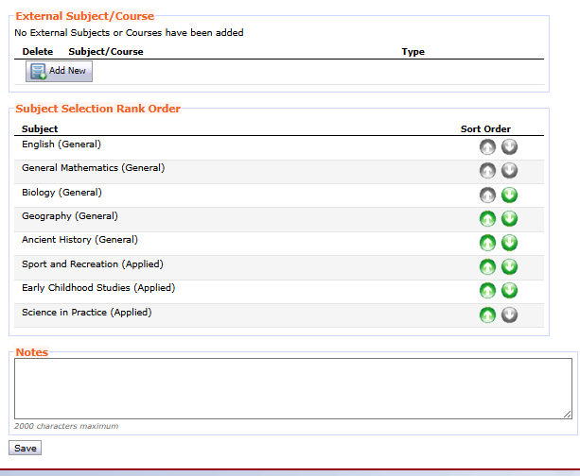
Order the subjects for what you want to most to least
Use the green arrows to re-order
Hit save

