Slide 1
Senior Science

Slide 2
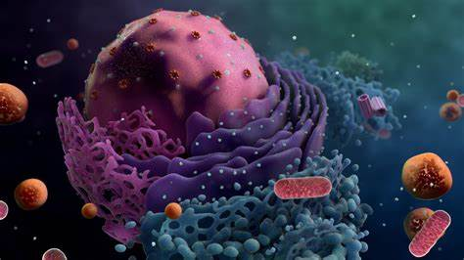
The study of living things
Biology
Teachers to talk to: Miss Taggart, Mr Bell, Mx Muller,

Slide 3
What is it? | The study of living organisms and how they interact with the non-living world
Areas of study | Cells and Multicellular organisms Maintaining the internal environment Biodiversity and the Interconnectedness of life Heredity and the continuity of life
Fun things | Ecology trip to Hastings Point
ATAR and Recommended Academic Achievement | ATAR eligible B in English OR Science/Science Elective It is recommended that you have strong reading/comprehension skills and the ability to write scientifically
Science @ Bremer

Slide 4
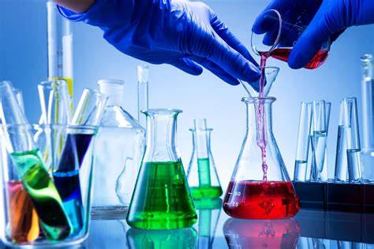
The study of chemical interactions.
Chemistry
Teachers to talk to: Mrs Margalit, Mrs Shepherd

Slide 5
What is it? | The study of chemical interactions
Areas of study | Chemical Fundamentals- Structure, properties and reactions Molecular interactions and reactions Equilibrium, acids and redox reactions Structure, synthesis and design
Fun things | Pracs! Making aspirin Distillation techniques Electroplating metals Titrations Acid/Base reactions
ATAR and Recommended Academic Achievement | ATAR eligible B in English OR Maths OR Science/Science Elective It is recommended that you have strong reading/comprehension skills, the ability to write scientifically and a grasp of basic Math

Slide 6
The study of the physical world (AKA Big Bang Theory)
Physics
Teachers to talk to: Mr Boyd, Mr Wilcox

Slide 7
What is it? | The study of the nature of the Universe
Areas of study | Thermal, nuclear and electrical Physics Linear motion and waves Gravity and electromagnetism Revolutions in modern Physics
Fun things | Quantum theory Theory of Relativity (E=mc²) Particle physics (the Hadron Collider
ATAR and Recommended Academic Achievement | ATAR eligible B in English OR Maths OR Science/Science Elective It is recommended that you have strong reading/comprehension skills, the ability to write scientifically and a grasp of basic Math (General or higher)

Slide 8
The study of behaviour and cognition
Psychology
Teachers to talk to: Mrs Wright, Miss Whybrow, Mrs Millers, Mrs Hoskin

Slide 9
What is it? | The study of behaviour and the underlying cognition
Areas of study | Individual development Individual behaviour Individual thinking The influence of others
Fun things | Learning about the brain! How to be motivated! Human (with permission) experiments!
ATAR and Recommended Academic Achievement | ATAR eligible B in English OR Maths OR Science/Science Elective It is recommended that you have strong reading/comprehension skills and the ability to write scientifically

Slide 10
The study of all Science for people who just enjoy a bit of Science!
Science in Practice-
Teachers to talk to: Miss Beggs, Mx Muller, Mr Beutler, Mrs Cowan, Ms Robinson, Mrs Hoskin. Mrs Wong

Slide 11
What is it? | The study of all Sciences with a focus on ‘hands on’ inquiry and scientific literacy
Areas of study | Forensics Weather Polymers Disease Food preservation Ancient ancestors Water Ancient weapons
Fun things | Pracs: Make Jam, Chutney, Yoghurt, Cheese and more Investigate a crime scene Make fake snow and slime Mini weapons of mass destruction (catapults and more) And much, much more
ATAR and Recommended Academic Achievement | Non-ATAR eligible No prerequisites, but an interest in Science and an inquisitive mind would be great!

